Slide 1
Guidance on preparing status update 4
Theme of this presentation is Requirement Validation (Range) Testing and Error/Exception Testing. Requirement validation testing shows that your system operates across all the ranges of operation specified in FSR/ICD and continues to function. Error/Exception Testing shows that when operated outside functional range, the system fails in ways that are predictable, safe, recoverable, and non-destructive. In industry this would be included in a System Test Plan Document
This update should cover what was accomplished in weeks 7 & 8 and what is planned for weeks 9 and 10 (This period is completion of Integration and mostly System Test)
All functional subsystem issues should be resolved by now. Integration planning should be complete. The majority of system integration should be complete. Functional system tests should be underway.
Additional tests in the test plan for range and error should indicate what FSR/ICD requirements test addresses, whether test can be destructive (result in permanent damage to the system -- these you generally will not conduct in capstone), as well as the date, time, tester, … from the Functional System Tests from last update. The status update should focus on Final Integration Status, Functional/Range/Error System testing.
You need to be starting system-level validation and planning for all of your Validation Tasks….this update requires you to show your validation plan
Notes:
Eric

Slide 2


Team 99: Project Name
Bi-Weekly Update 4 Team members list Sponsor: Sponsor Name TA: TA Name
Intro should take 30 seconds
Notes:
Michelle

Slide 3
Project Summary (30 seconds)
What is the problem that we are solving
High-level summary of what system does to solve the problem
Picture / Diagram here
Notes:
Kyle

Slide 4
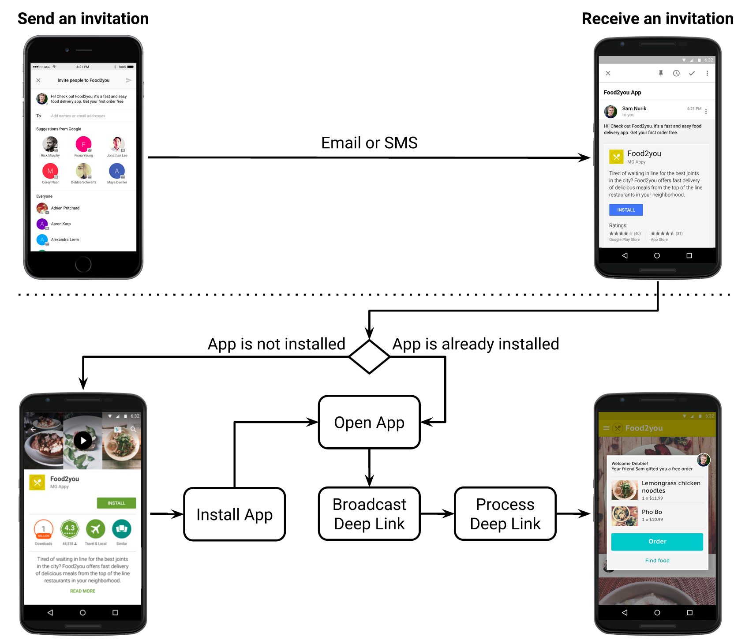
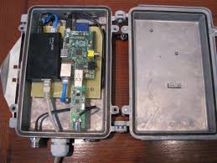
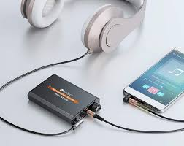
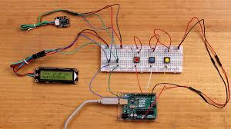
Integrated System Diagram (90 seconds)
NOTE this is not your usual system block diagram
This should show the complete system – with picture of packaged solution or conceptual diagram of packaged solution. Use this to describe how user interacts with system and how system interacts with external environment. Show how it connects to the outside world (communication, interfaces). If appropriate show internal breakdown and interfaces. SW projects should show data repository/db; mobile/web app connectivity; front end vs backend; and give representative screens users will see – real look-and-feel
Unacceptable – not integrated
Good – shows enclosure, integrated system. Just label things
Better – Shows packaged amplifier, app for interface, and users headphones
Good – Shows solution with user experience in interacting with SW
Notes:
Eric

Slide 5
Project Timeline (45 seconds)
Target or actual dates within or above boxes – green done, yellow underway, red deadline or function at risk, white not started
Subsystem Designs and Testing (completed 9/11) | Integration of motor subsystem and MCU (completed 9/17) | Integration of Bluetooth and iPhone App (completed 9/28) | Final Integration (completed 10/15) | System Test (to complete by 11/2) | Validation (to complete by 11/26) | Demo and Report (to complete by 12/5)
-- Just quick overview…do not talk about work completed weeks ago, concentrate on past few weeks and upcoming activity.
-- Save detail for execution plan & validation plan status
Notes:
Eric

Slide 6
Team Member 1 (30 seconds)
You should be putting 7-10 hr/week on capstone!
This should not be just subsystem status!
At this point it should be review of the System Integration and Test activities led by Team Member 1
Accomplishments since last update XX hrs of effort | Ongoing progress/problems and plans until the next presentation
What has been accomplished since last review | What are you going to accomplish in the next 2 weeks
For 4th review Accomplishments should include what integration and functional/range/error system testing completed and planned for next 2 weeks”
“Completed integration of all subsystems”
“Verified sensor data capture and communication through Bluetooth to App”
“Integrated image detection model on Pi-4 on drone, tested detection accuracy”
“Tested app error handling for stuck valve & thermal range exceeded cases”
“ON-GOING automated software testing”
“Range testing of LoRa network from 10m to 5km with 35 points in BCS”
“Rover motor stall test with 2x max payload and 40º elevation by next review”

Slide 7
Team Member 1 (45 seconds)
This should all be test results! – show things working, functional test results, error checking, etc
Show test results for integrated systems

Slide 8
Execution Plan (Show for 45 seconds)
Execution plan
Your team planned milestones for completion of any remaining integration, functional, range, and error test, and validation plans should be presented.
Milestones should have owners … system tests, and full system integration can be group owned
Engineering milestones only [presentation, demo, document due dates are project milestone that do not belong on this chart]
Gantt chart.
DO NOT try to discuss all milestones in the plan – just high priority present and next engineering milestones
Notes:
Michelle

Slide 9
SYSTEM Validation Plan (Show for 1 minute)
Validation plan
This is not a gantt chart.
Validation plan is a table showing:
Name: descriptive short description of what is being validated,
Requirement: Identifer to link to requirement # from conops/fsr/icd
Success Criteria for validation – range/lifetime/performance metric/physical limit…that must be met.
Methodology – test procedure followed/observations made/simulations completed/.. to satisfy the validation
Responsible party
Status – complete/not complete
Notes:
Michelle

Slide 10
Final slide – thank your audience

